Slide 1

Web Development with Python/Django
Dr. Abdelhameed Ibrahim
Assoc. Prof. of Computer Engineering

Slide 2

Learning Objectives
First, you will learn
Using Django web application
Creating a virtual environment (Anaconda)
Setting up Projects and Applications
Using simple Templates and tags
Creating Views and Mapping URLs
2

Slide 3
Using Templates
Understanding how Django functions and interacts with your website requires a thorough understanding of templates.
3

Slide 4
Using Templates
First build a templates directory followed by a subfolder for each app's templates.
It goes in your directory's top level:
first_project/templates/first_app
4

Slide 5
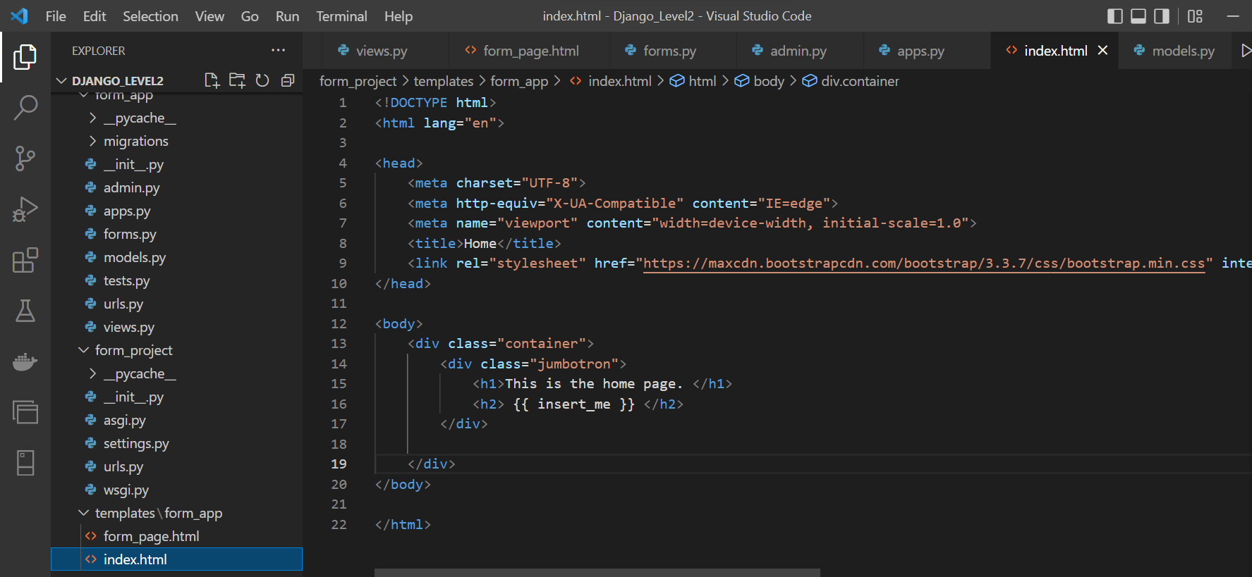
Using Templates

Slide 6
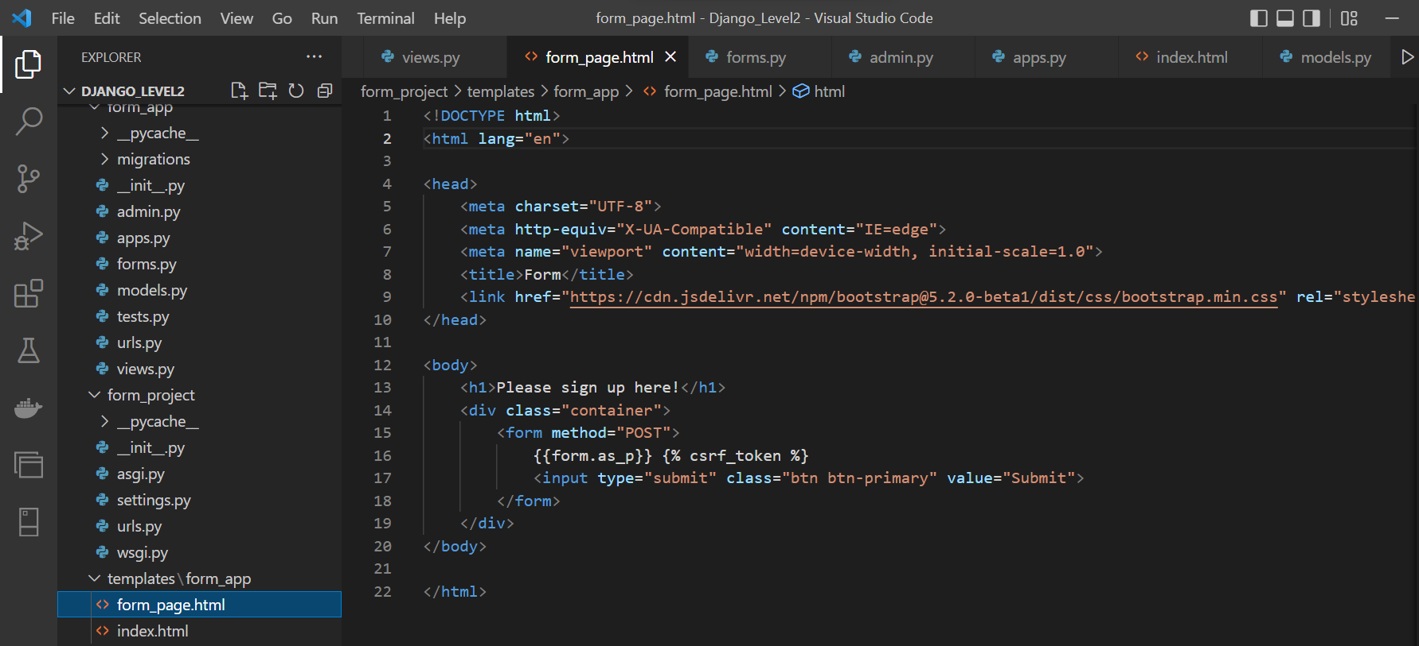
Using Templates

Slide 7
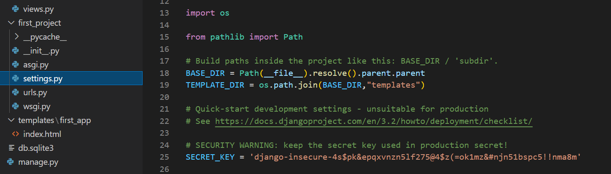
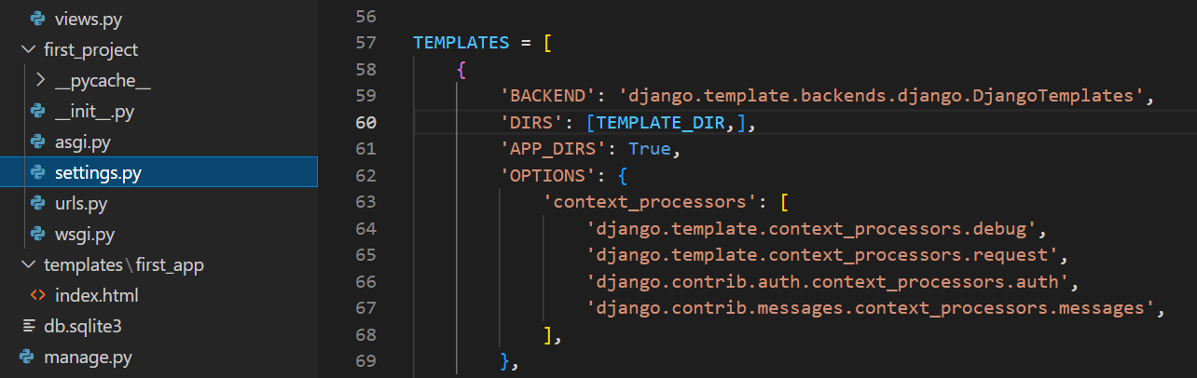
Using Templates
7

Slide 8
Learning Objectives
First, you will learn
Using Django web application
Creating a virtual environment (Anaconda)
Setting up Projects and Applications
Using simple Templates and tags
Creating Views and Mapping URLs
8

Slide 9
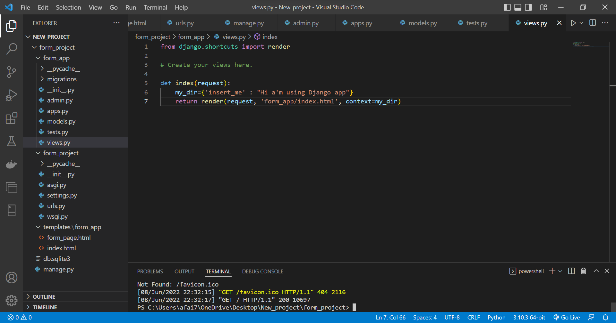

Slide 10
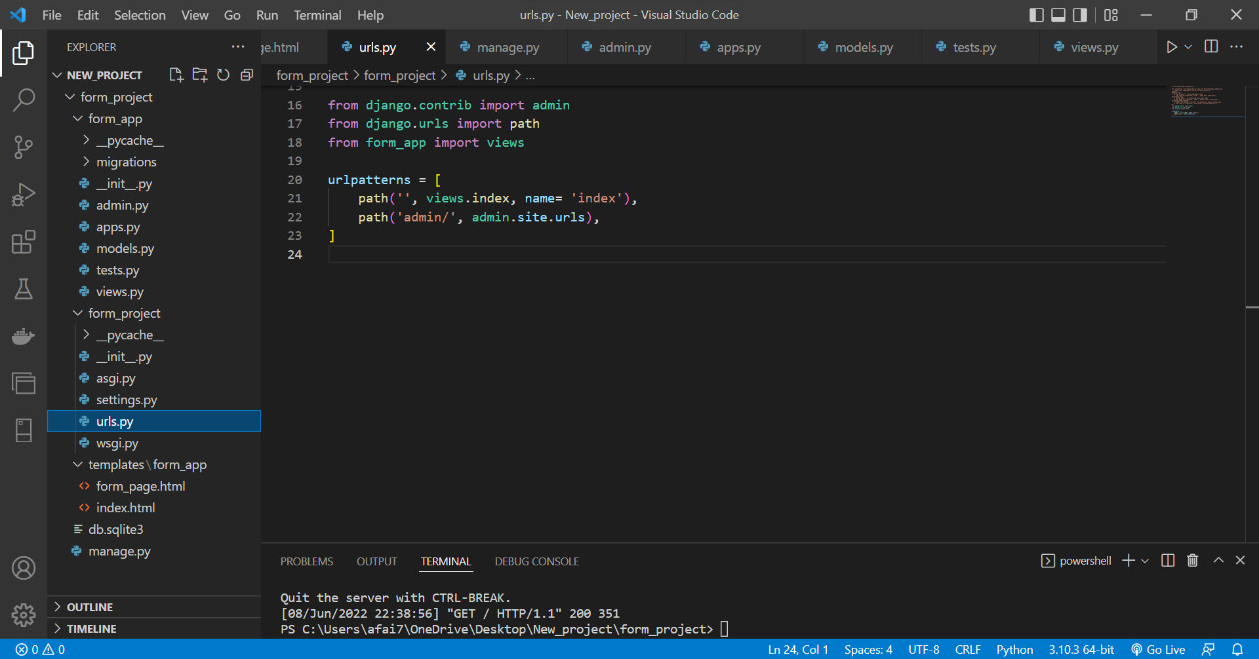

Slide 11
Django – Challenge 1
Time to put your skills to the test!
11

Slide 12
Challenge 1
Complete the following tasks:
Create a New Django Project
Create a New Django App
Create an Index View
Link this view to the urls.py file
12

Slide 13
Learning Objectives
Then, you will learn
Creating a model
Using the Admin interface
Using Django Forms
Connect the form in the template
Accepting User Input and connect it to the database
13

Slide 14
Models
We use Models to incorporate a database into a Django Project.
To create a model, a class structure is used inside of the relevant applications models.py file
14

Slide 15
Models
This class object will be a subclass of Django’s built-in class:
django.db.models.Model
Then each attribute of the class represents a field
15

Slide 16
Models
Here is what you have to do:
Add a new model called User
It should have these fields:
First Name
Last Name
Email
16

Slide 17
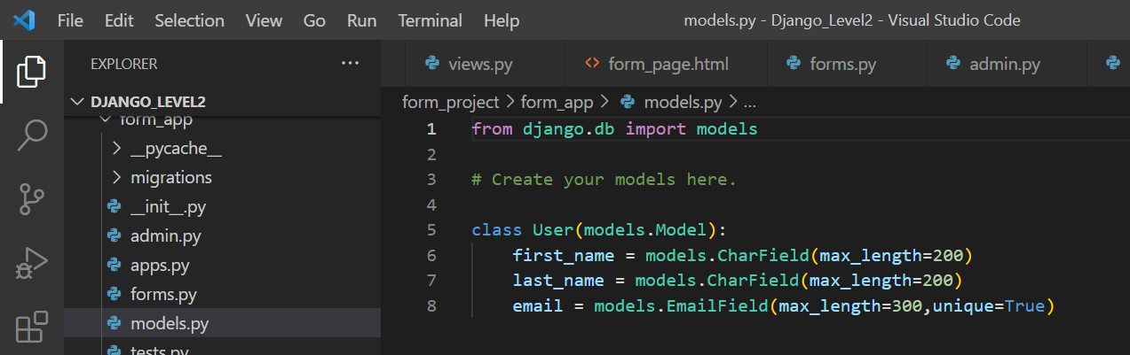
Models
17

Slide 18
Models
Migrate the database (creating databases that correspond to the models we created)
python manage.py migrate
python manage.py makemigrations form_app
python manage.py migrate
18

Slide 19
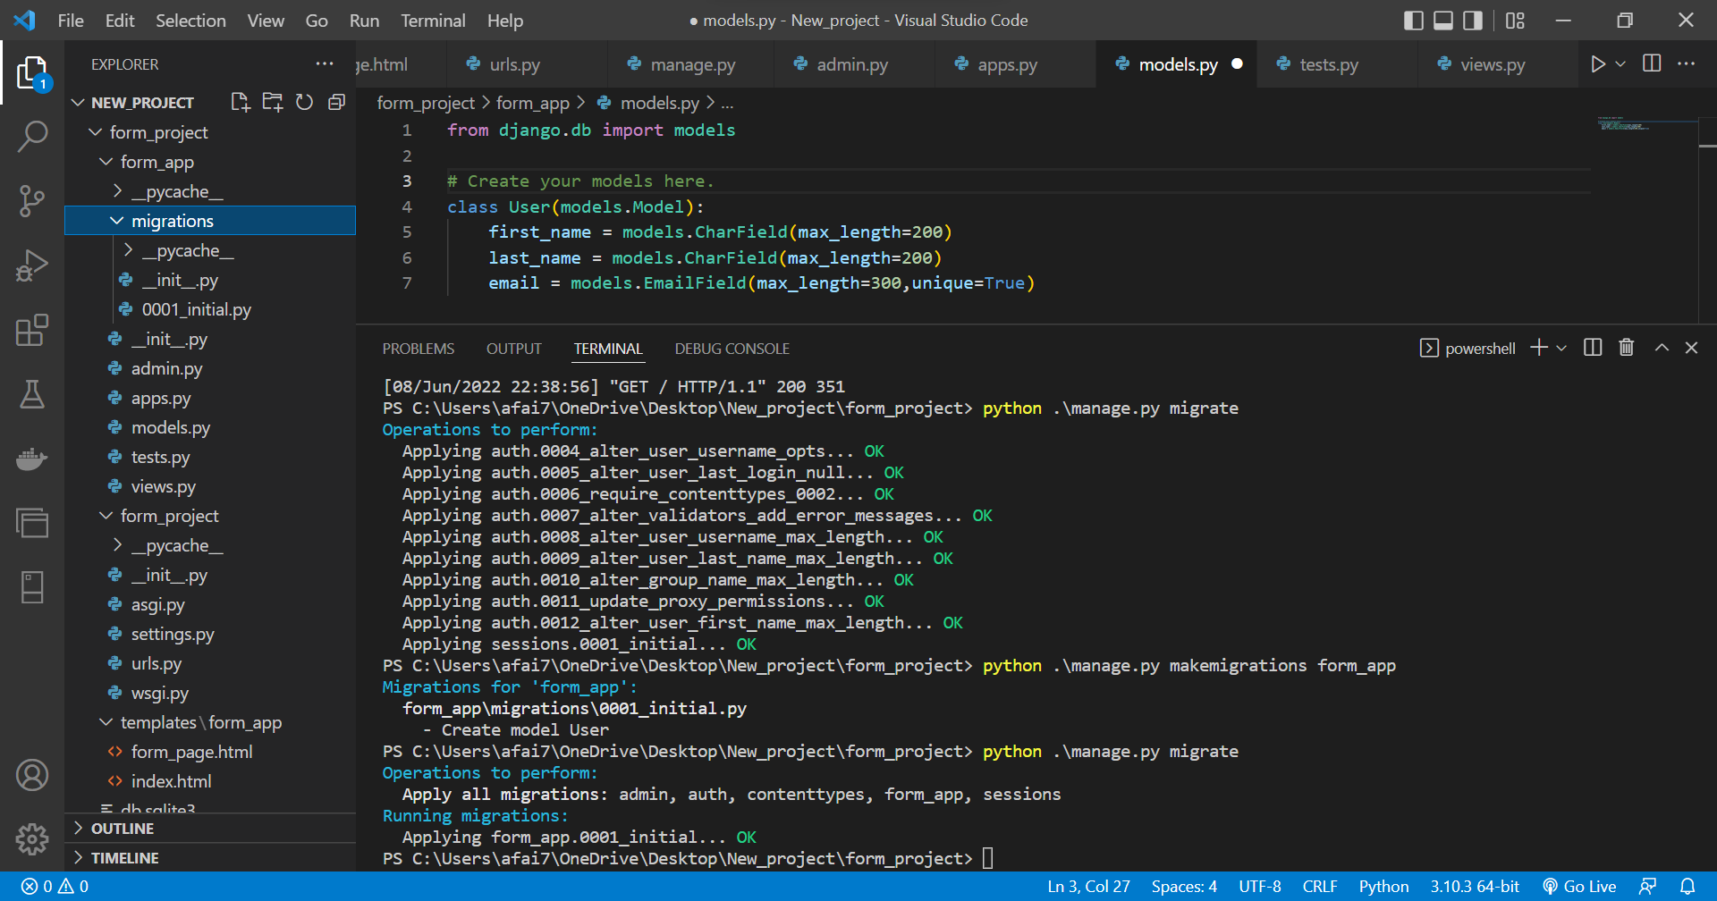

Slide 20
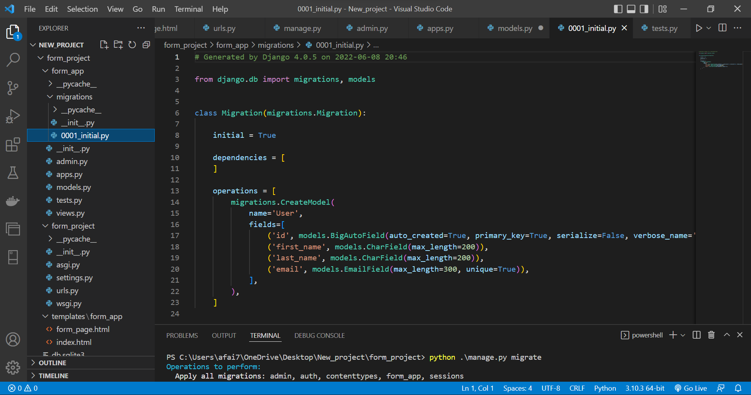

Slide 21
Learning Objectives
Then, you will learn
Creating a model
Using the Admin interface
Using Django Forms
Connect the form in the template
Accepting User Input and connect it to the database
21

Slide 22
Django Admin interface
To use the Admin interface with the models, we need to register them to our application’s admin.py file.
admin.site.register(User)
This Admin interface is one of the key features of Django!
22

Slide 23
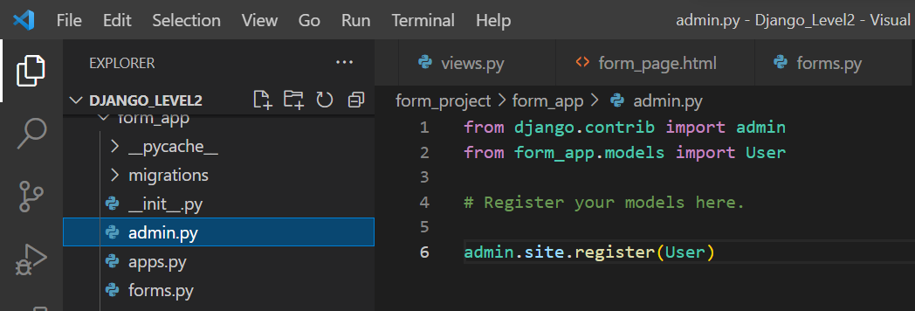
Django Admin interface
23

Slide 24
Django Admin interface
In order to fully use the database and the Admin, we will create a “superuser”
Providing a name, email, and password
Use:
python manage.py createsuperuser
24

Slide 25
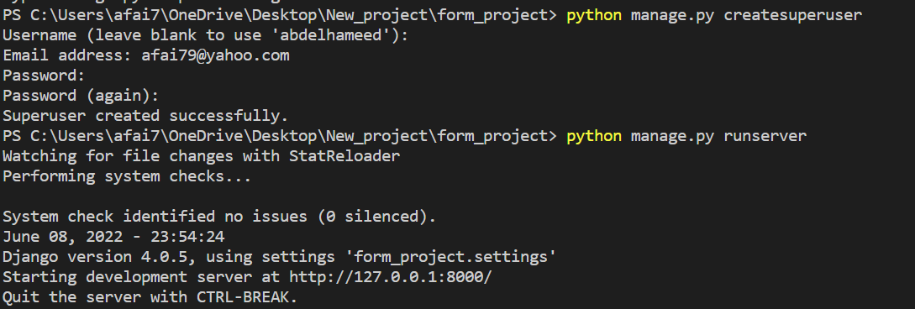
Django Admin interface
25

Slide 26
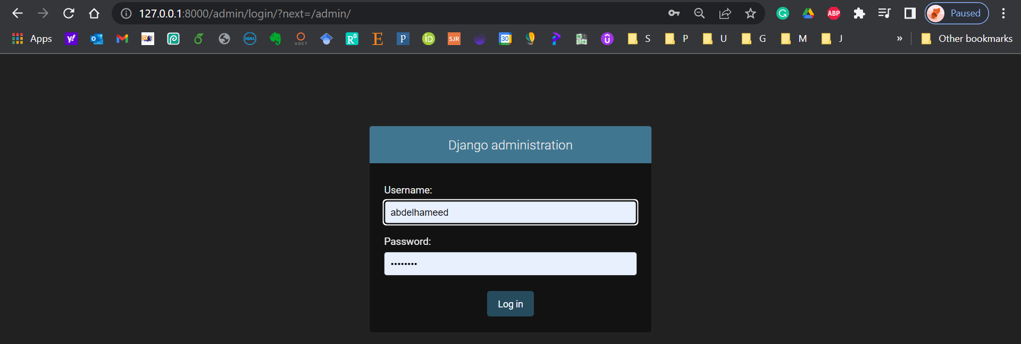
Django Admin interface
26

Slide 27
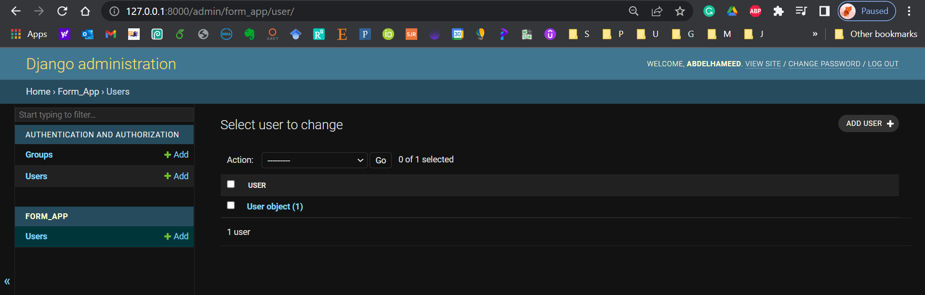
Django Admin interface
27

Slide 28
Learning Objectives
Then, you will learn
Creating a model
Using the Admin interface
Using Django Forms
Connect the form in the template
Accepting User Input and connect it to the database
28

Slide 29
Forms
First, create a forms.py file inside the application!
Create a form from a pre-existing model, use forms.ModelForm
Meta class provides information connecting the model to the form.
29

Slide 30
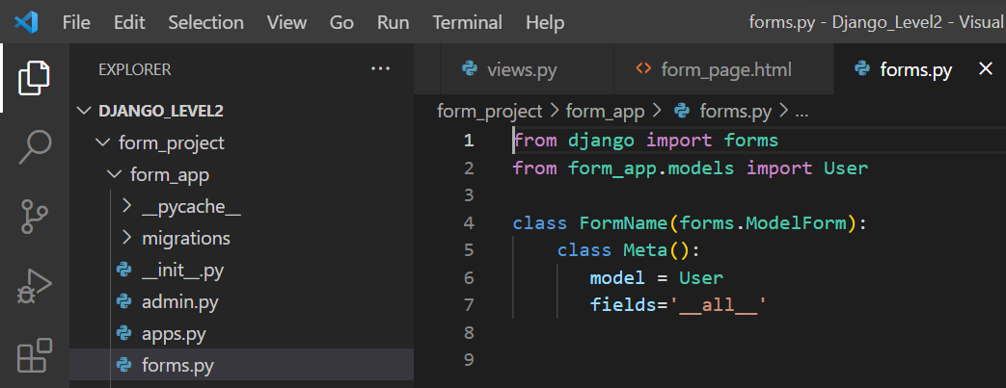
Forms
30

Slide 31
Learning Objectives
To achieve this, then, you must learn
Creating a model
Using the Admin interface
Using Django Forms
Connect the form in the template
Accepting User Input and connect it to the database
31

Slide 32
Forms
Now we need to show form created inside the application’s forms.py file by using a view!
Inside our views.py file we need to import the forms
from .forms import FormName
32

Slide 33
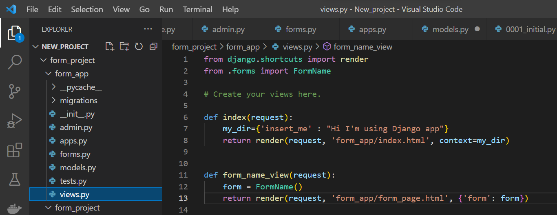
Forms, update views
33

Slide 34
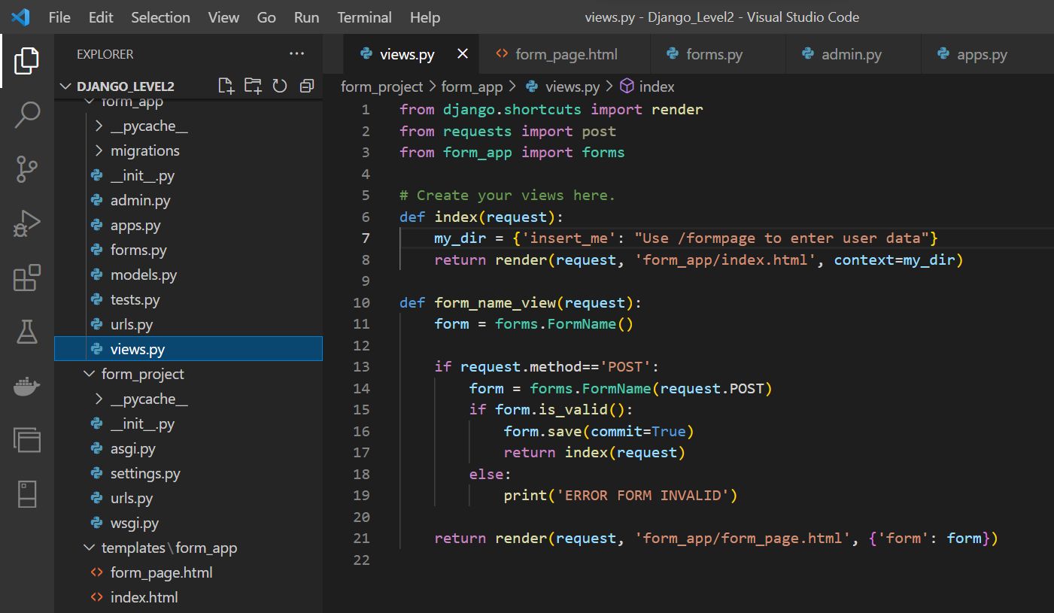

Slide 35
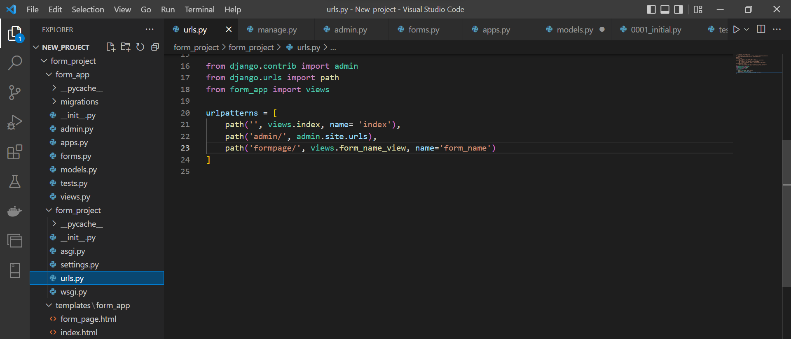
Forms, update urls

Slide 36
Forms
There are several ways you can “inject” the form using template tagging.
You can just pass in the key from the context dictionary:
{{ form }} or {{ form.as_p }}
36

Slide 37
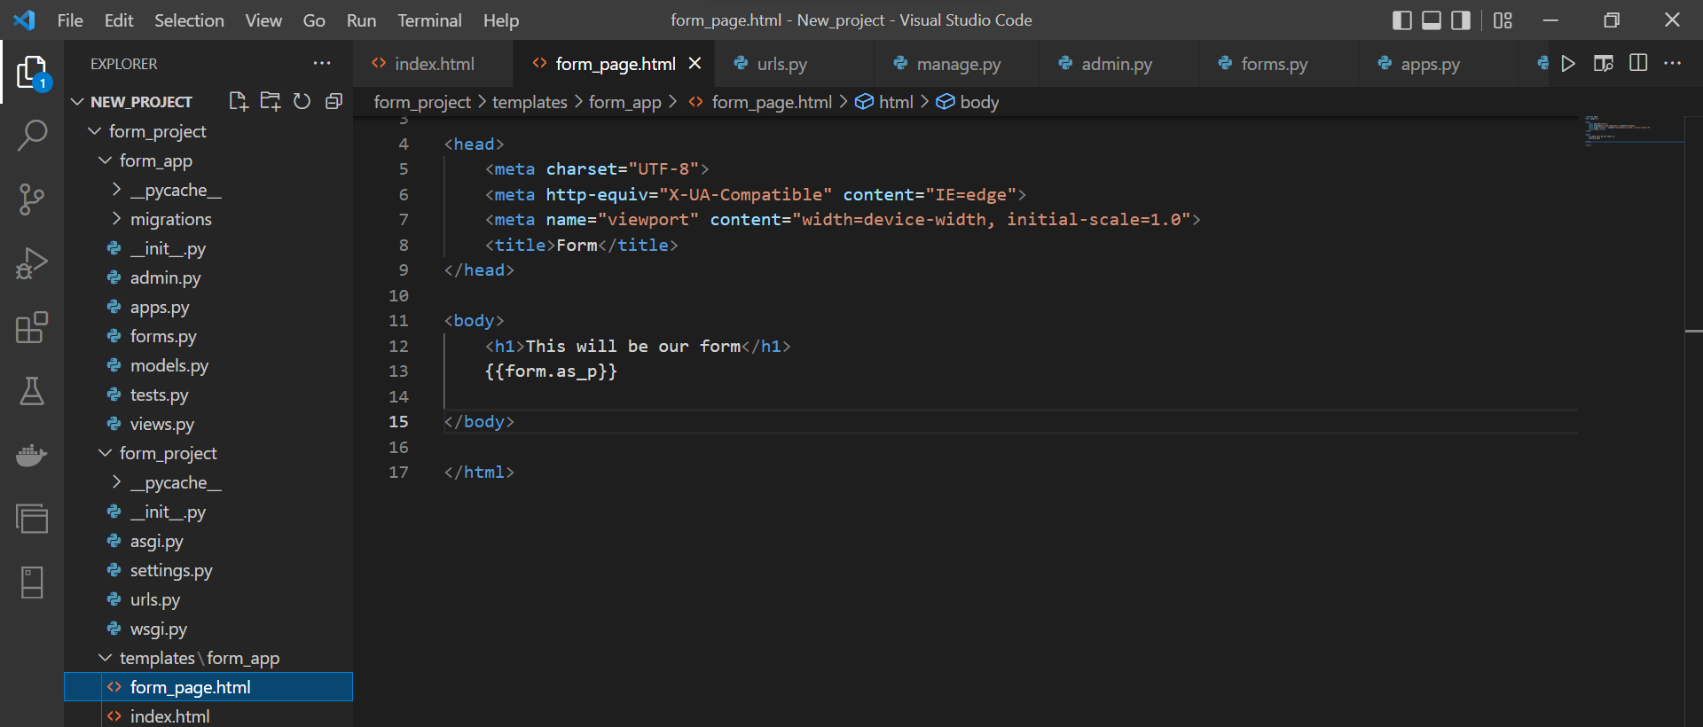
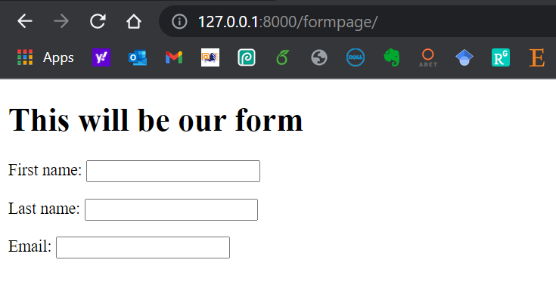
Forms

Slide 38
Learning Objectives
To achieve this, then, you must learn
Creating a model
Using the Admin interface
Using Django Forms
Connect the form in the template
Accepting User Input and connect it to the database
38

Slide 39
Forms and Models
Adding form and button to the html file
Using Bootstrap to improve the shape of the website
39

Slide 40
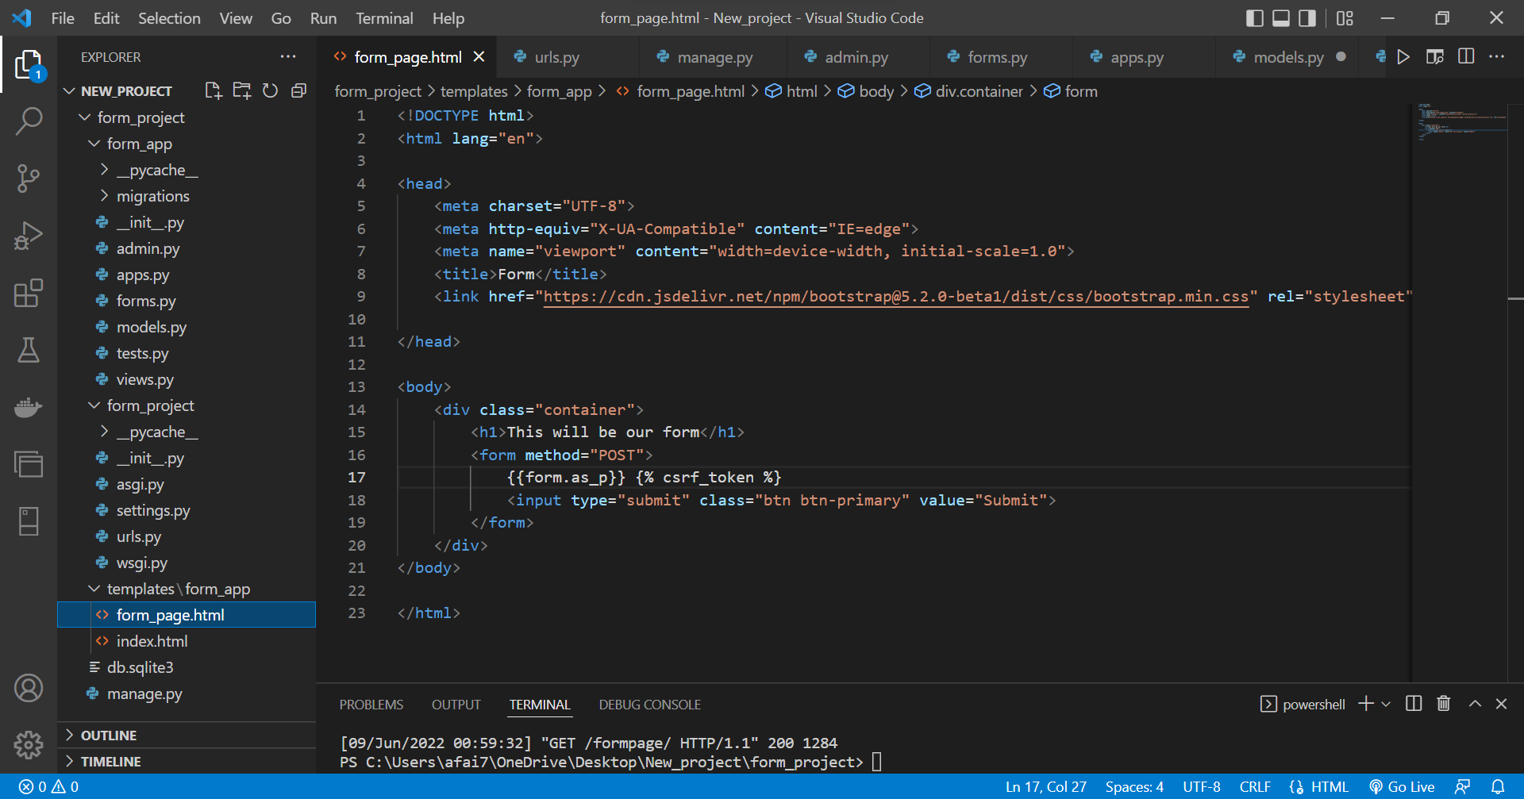

Slide 41
Forms and Models
Update views by this to save data
if request.method=='POST':
form = FormName(request.POST)
if form.is_valid():
form.save(commit=True)
return index(request)
else:
print('ERROR FORM INVALID')
41

Slide 42
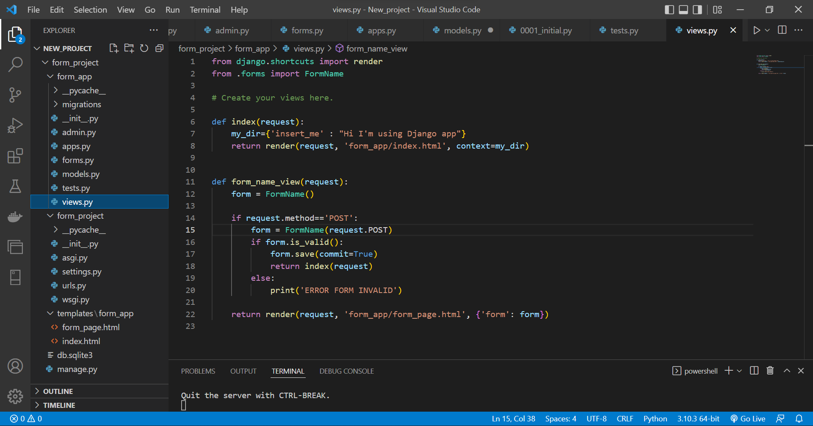

Slide 43
Model Forms - Run
43

Slide 44
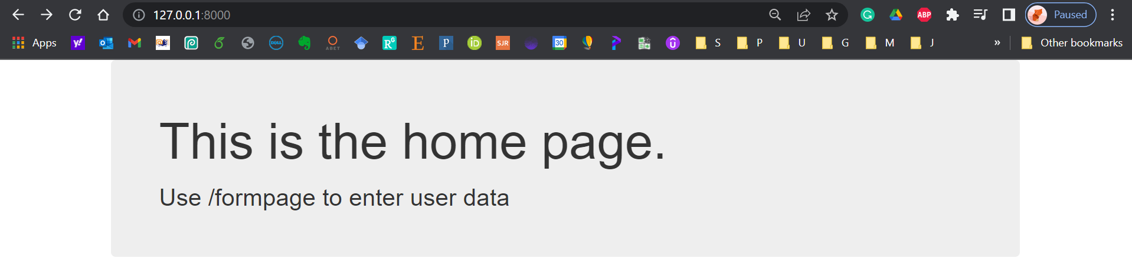
Home Page
44

Slide 45
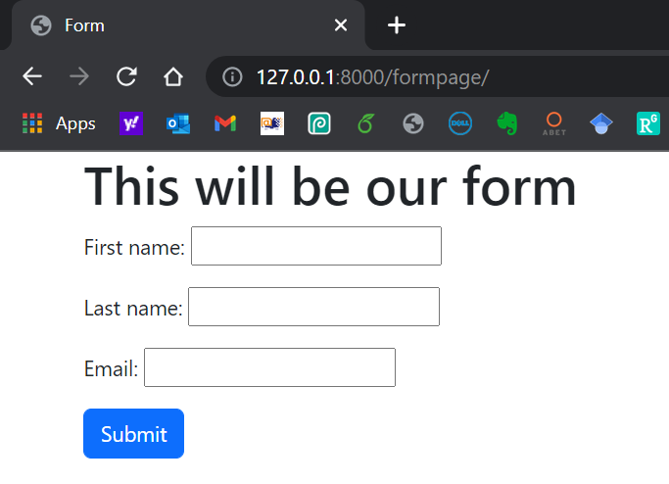
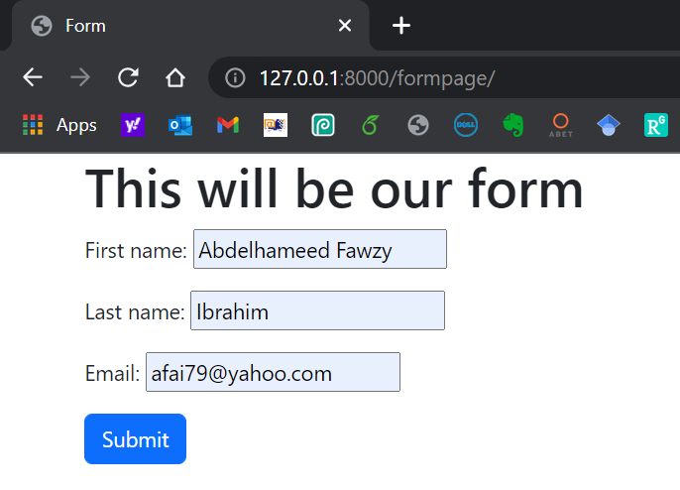
Form Page
45

Slide 46
Django Admin
46

Slide 47
Django Admin
47

Slide 48
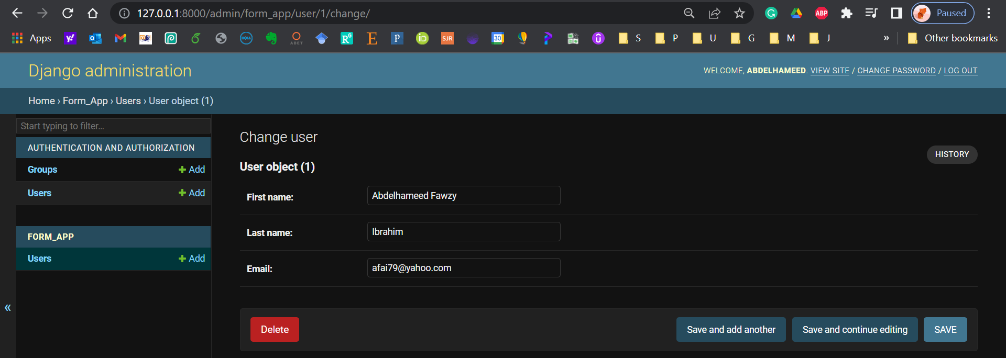
Django Admin
48

Slide 49
Learning Objectives - Confirm
You are now able to
Develop a web form that enables the user to insert data into the database using the form.
49

Slide 50

Learning Objectives - Confirm
You can download the code created in this Training from my GitHub account:
https://github.com/afai79/Django-Python
50

Slide 51
Django – Challenge 2
Model Forms
51

Slide 52
Challenge 2
Complete the following task:
Develop a Django web form that enables the user to insert data (username, password) into the database using a form (login).
52

Slide 53


Thanks
Dr. Abdelhameed Fawzy

